Slide 1

“dodge race” Game project
Elmir bekmurzaev / samat baygeldiev

Slide 2
For install
Pygame module
Python

Slide 3
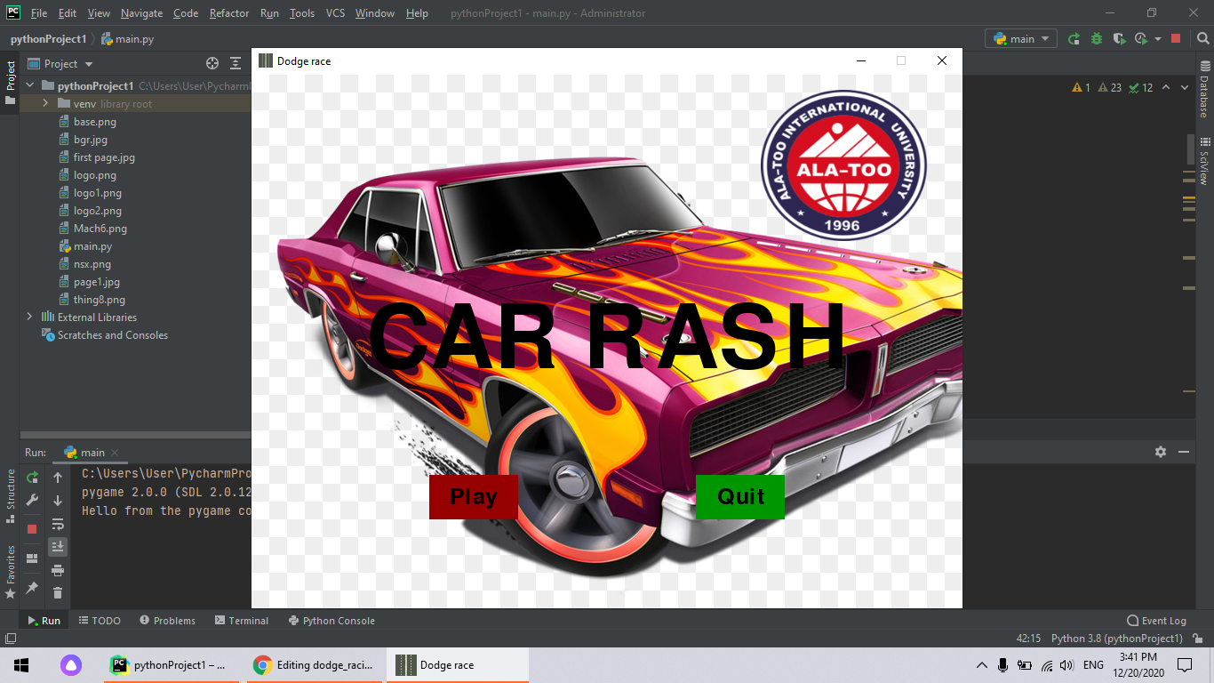
introduction
“Dodge racing”
This is the simple game with some obstacles on the track,
You must to avoid this obstacles and get the points.
IN ORDER TO START THE GAME
PRESS: “Play” BUTTON
IF YOU WANT EXIT FROM THE GAME
PRESS: “Quit” BUTTON

Slide 4

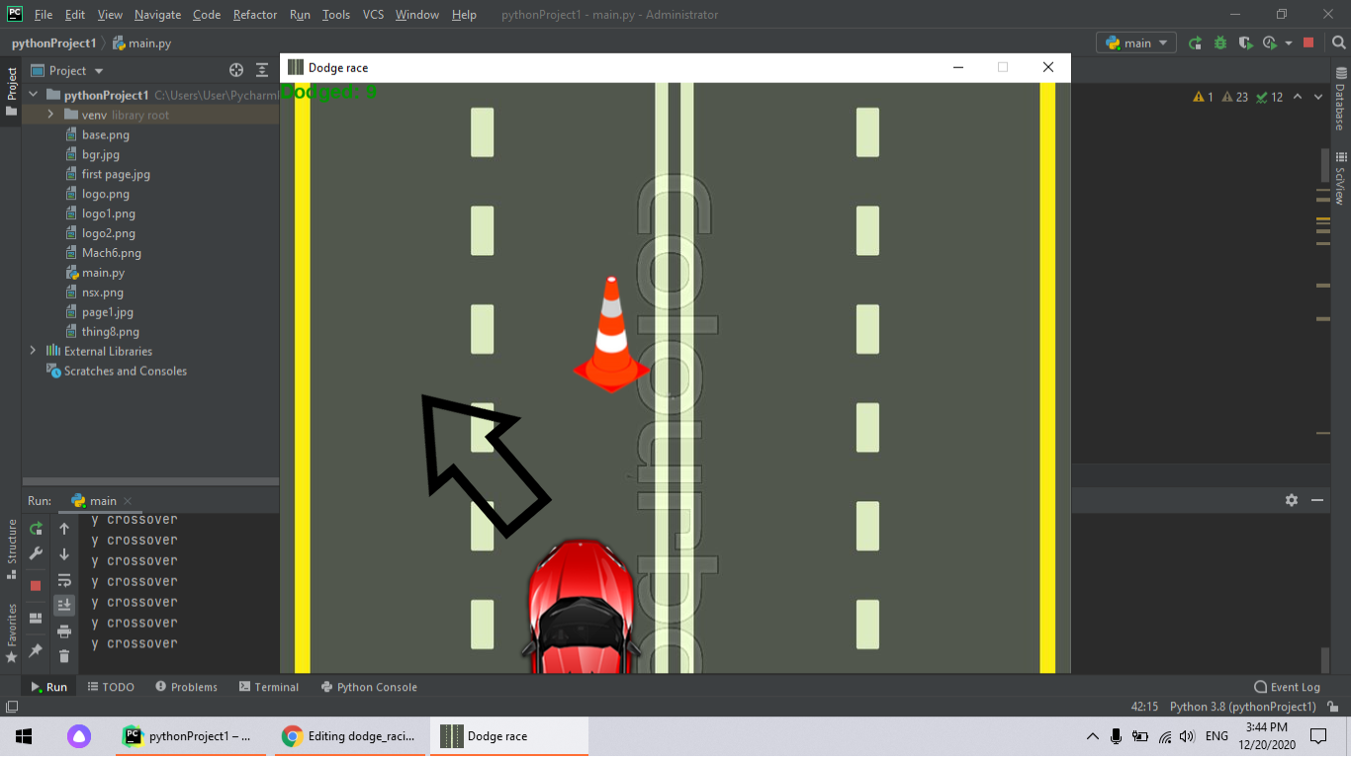
Drive the car with key RIGHT AND LEFT

Slide 5
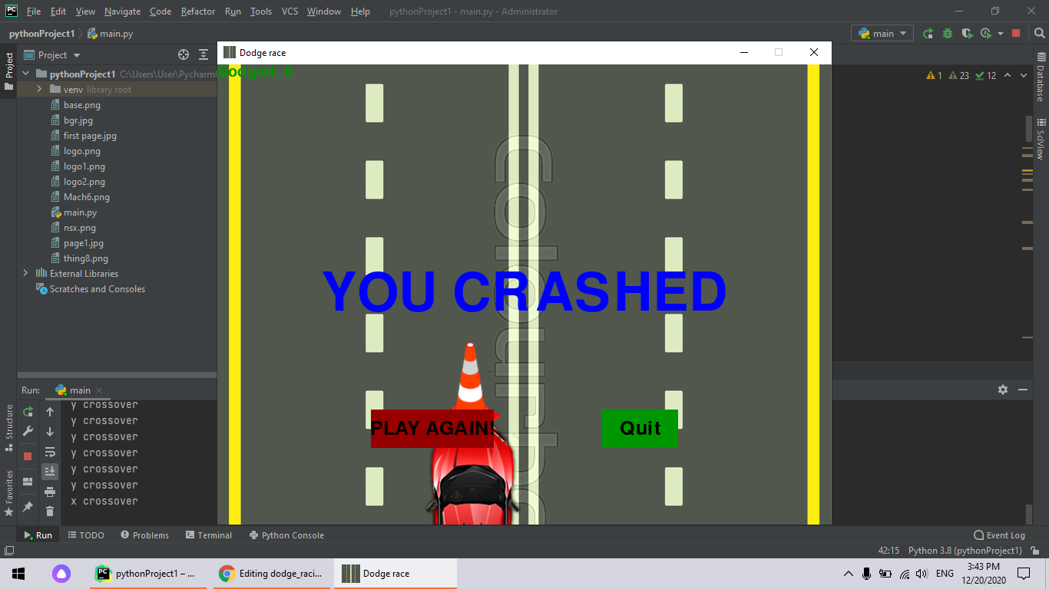
IF YOU CRASHED THE GAME WILL OVER.

Slide 6
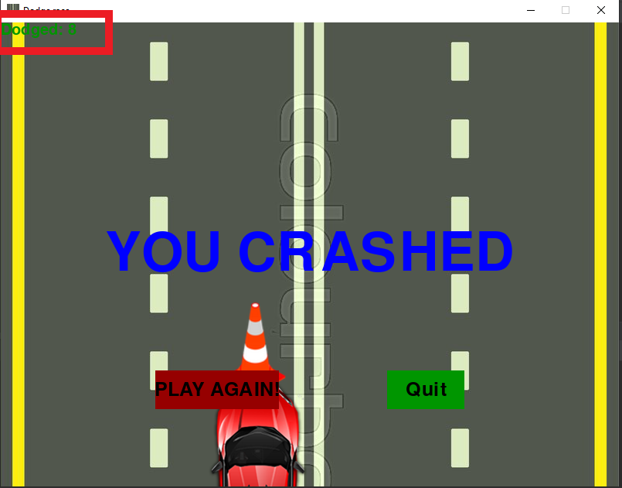
YOU CAN CHECK YOUR SCORE ON THE LEFT – TOP OF THE SCREEN

Slide 7
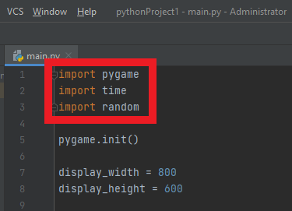
LIBRARIES
PYGAME
TIME
RANDOM

Slide 8
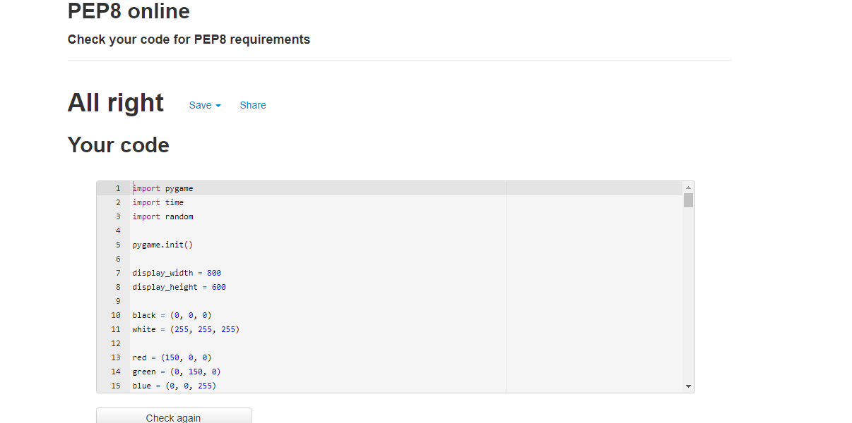
DESIGN
Checked by : http://pep8online.com

